Slide 1
SISTEMAS OPERATIVOS
SO
E – M 2019

Slide 2
Processes
Process Scheduling

Slide 3
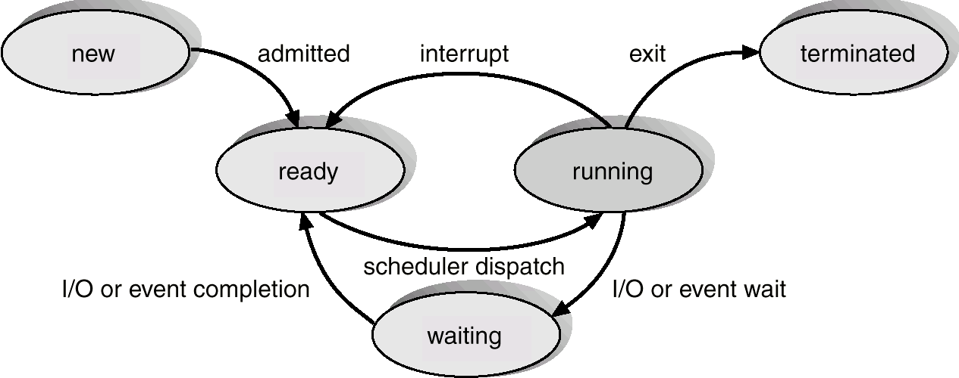
Scheduling Process States
[finished]
[timeout]
[blocked]
Explain the CPU Context Switch?

Slide 4
Process Scheduling (with Queues)
Queueing diagram represents queues, resources, flows
READY queue
cpu
i/o
WAITING queue
I/O request
time slice
expires
child
executes
join
fork a
child
WAITING queue
WAITING queue
resource
request

Slide 5
Op Sys Control Structures
Memory Tables
Process Image
Memory
I/O Tables
User data
User program
System stack
+ PCB
I/O
Files
File Tables
Processes
Process Tables
Process 1
Process 2
…
Process N

Slide 6
Scheduler?
How come, the Scheduler, “at the same time” can do?
Manage the CPU Context Switch between Processes
Running >> Ready, or
Running >> Terminated, or
Running >> Waiting; and
Ready >> Running
New, or Terminate Processes
Swap-out, or Swap-in Processes
To, and From disk

Slide 7
Schedulers
Three types of schedulers, by function
Short-term scheduler (CPU scheduler)
Long-term scheduler (Job scheduler)
Medium-term scheduler

Slide 8
Schedulers por función
Short-term scheduler, (or CPU scheduler)
Selecciona, de READY, cual es el siguiente proceso a ser ejecutado y le asigna CPU; Running>, >Ready>, >Waiting.
Invocado frecuentemente (milliseconds), debe ser rápido
Algunas veces el único Scheduler en el sistema, p.e. en _____
Long-term scheduler, (or Job scheduler)
Selecciona cuales procesos deben ser traídos a la cola de READY (a memoria): New>.
Termina administrativamente con los procesos: >Terminated.
Invocado infrecuentemente (segundos, minutos), puede ser lento
Controla el grado de multiprogramación

Slide 9
Schedulers: Short-term, Long-term
Long-term Scheduler
Short-term Scheduler
[finished]
[blocked]

Slide 10
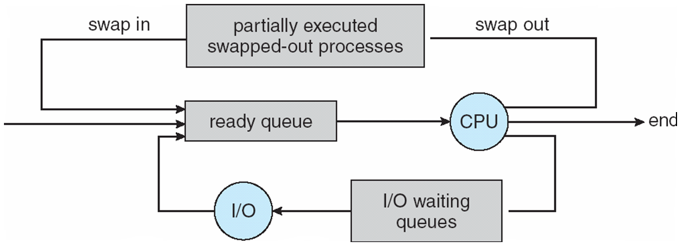
Agregación del Medium Term Scheduling
Puede ser agregado y sirve para controlar el grado de multiprogramación
Remueve procesos de memoria y los almacena en disco (reduce el grado), vuelve a traerlos de disco a memoria (incrementa el grado) para continuar la ejecución: swapping

Slide 11
Reasons for process suspension
SWAPPING: the OS needs to release sufficient main memory to bring in a process that is ready to execute. The OS must found one or more processes with a lower priority to release memory.
Interactive user request: a user may wish to suspend a process for purposes of debugging or in connection with the use of a resource.
Timing: a process may be execute periodically (e.g. an accounting or system monitoring process) and may be suspended while waiting for the next time interval.
Parent process request: a parente process may wish to suspend execution of a descendent to examine or modify it, or to coordinate the activity of varios descendents.
Other OS reason: the OS may suspend a background, utility process or a process that is suspected of causing a problem.

Slide 12
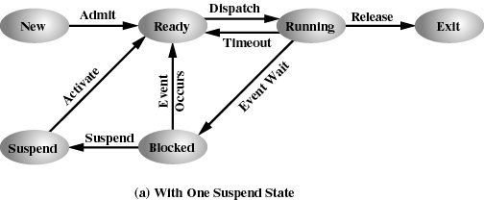
+ Suspend State

Slide 13
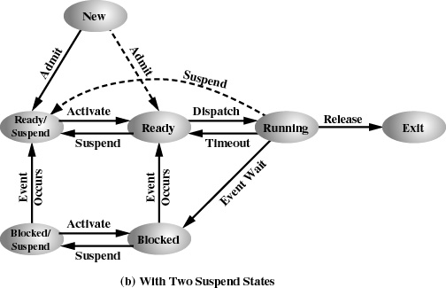
+ Two Suspend States

Slide 14
References
Presentación de Ramón Ríos.
Capítulos: Operating System Concepts; Silberschatz, Galvin, Gagne.
12-feb-2019

